Slide 1



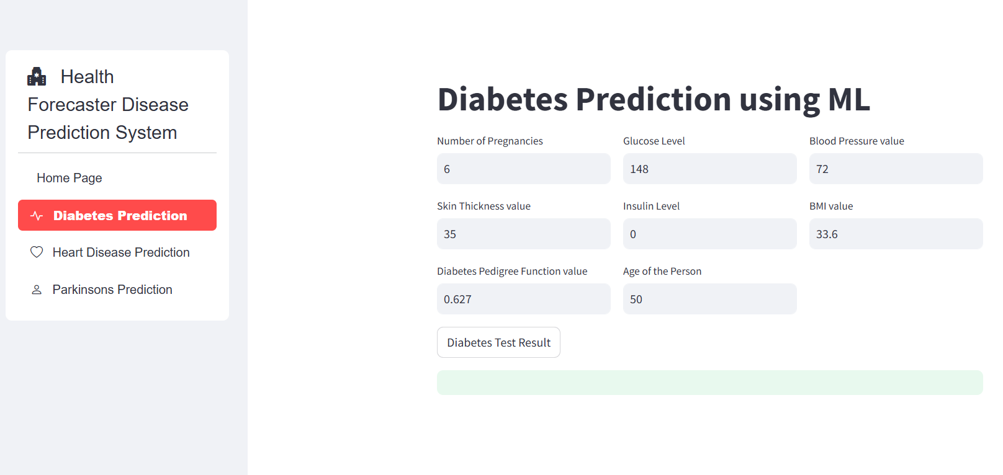
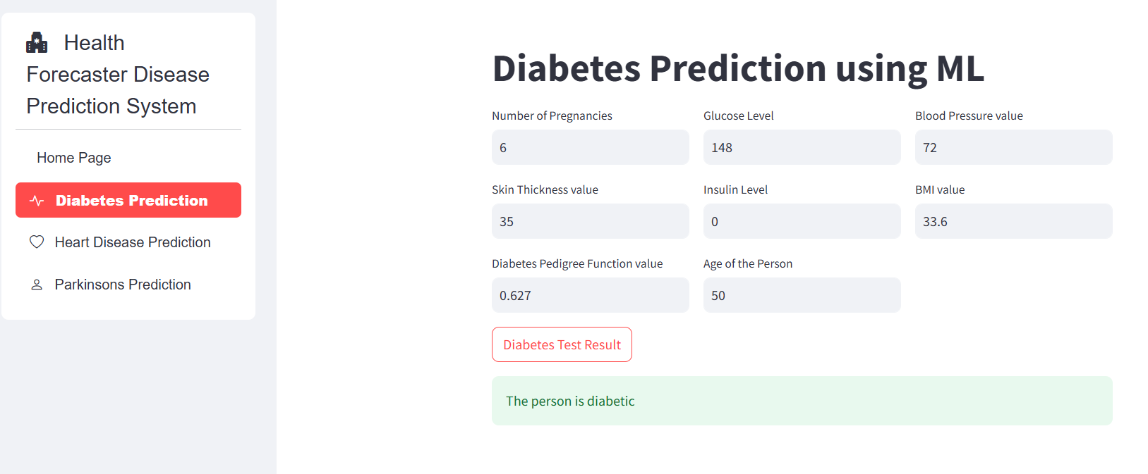
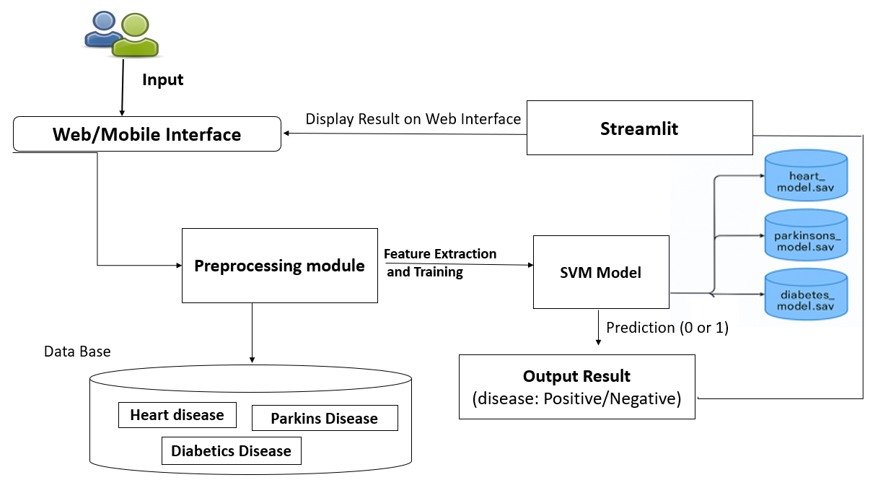
Health Forecaster Multi-Disease Prediction System
Department of Information Technology
School of Computing
10214IT602– MINOR PROJECT-II
WINTER SEMESTER 2024-2025
ABSTRACT
RESULT
STANDARDS AND POLICIES
As healthcare data becomes more abundant, machine learning is proving to be a powerful tool for disease prediction and diagnosis. This project aims to develop a multi-disease prediction system using advanced machine learning techniques to enhance early diagnosis and support effective treatment planning.
The proposed model can predict multiple diseases such as diabetes, heart disease and parkin's disease. If left untreated, these diseases pose a risk to humanity. As a result, many lives can be saved by early detection and diagnosis of these disorders. The proposed model leverages various supervised learning algorithms including logistic regression, support vector machines (SVM), to analyze patient data and predict the likelihood of multiple diseases such as diabetes, heart disease, and parkin's disease.
INTRODUCTION
Anaconda prompt is a type of command line interface which explicitly deals with the Machine Learning modules and navigator is available in all the Windows ,Linux and MacOS. The anaconda prompt has many number of IDE’s which make the coding easier. The UI can also be implemented in python.
Standard Used: ISO/IEC 27001.
The Health Forecaster Multi-Disease Prediction System has the potential to make a significant impact on individual health, healthcare systems, and society at large. The healthcare paradigm is shifting from treatment to prevention. This project supports early diagnosis and prevention, which can save lives, reduce healthcare costs, and improve quality of life. Rural and remote areas often lack access to advanced medical facilities. This system can bridge the gap by providing predictive insights remotely, reducing the dependency on physical healthcare infrastructure. Many healthcare systems, especially in developing regions, face shortages of medical professionals, diagnostic tools, and resources
The diabetes prediction system successfully classifies individuals as diabetic or non-diabetic based on input medical parameters. Using an SVM classifier with a linear kernel, the model achieves a good accuracy score on both training and testing datasets, demonstrating its effectiveness. Early disease prediction and management reduce complications, enabling individuals to lead healthier and longer lives.
Figure 1. Input .
Figure 2. Output
METHODOLOGIES
CONCLUSION
The Multi-Disease Prediction System using Machine Learning provides an efficient and accurate approach to early diagnosis and risk assessment of multiple diseases. By leveraging data preprocessing, feature selection, and machine learning algorithms, the system can analyze patient data and provide reliable predictions. Encourages individuals to adopt preventive health measures by identifying potential risks early.
The Creates a user-friendly interface using Stream lit, allowing users to initiate conversations, select languages, and manage security settings with real-time translation display. Real-Time Translation Engine Implements advanced NLP models (e.g., BERT, GPT) for accurate and instantaneous multilingual translation, trained on diverse datasets for improved performance. Cryptographic Security Integrates AES for end-to-end encryption, RSA for secure key exchange and digital signatures, and SHA-256 for message integrity verification to ensure data confidentiality and authenticity. Applies techniques such as key pinning and certificate validation to prevent Man-in-the-Middle attacks and secure message transmission.
TEAM MEMBER DETAILS
The IoT-based system for water pollution monitoring involves the use of sensors to
1.VTU 21371/A. Nancy Mary
2.VTU 26714/G. Hariharan
3.VTU 21445/S. Mohammed Shareef
1.8925764031
2.8939748161
3.9751724774
1.vtu21371@veltech.edu.in
2.vtu26714@veltech.edu.in
3.vtu21445@veltech.edu.in
ACKNOWLEDGEMENT
Supervisor Name : Dr. C. SURESH KUMAR, M.E. Ph.D., Assistant Professor
Contact No : 9500684095
Mail ID : drsureshkumarc@veltech.edu.in
Architecture Diagram: Health Forecaster Multi disease prediction System

